Slide 1

CSE 473: Pattern Recognition

Slide 2
Unsupervised Learning:
Clustering

Slide 3

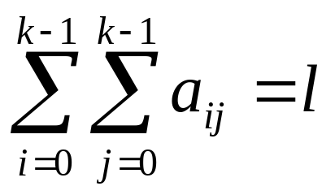
Proximity Measures Between Discrete-Valued Vectors
  Let F={0,1,…,k-1} be a set of symbols and X={x₁,…,x_{N}} ⊂ F^{l}
  Let A(x,y)=[a_{ij}], i, j=0,1,…,k-1, where a_{ij} is the number of places where x has the i-th symbol and y has the j-th symbol.
Example: l=6, k =3
NOTE:

Slide 4
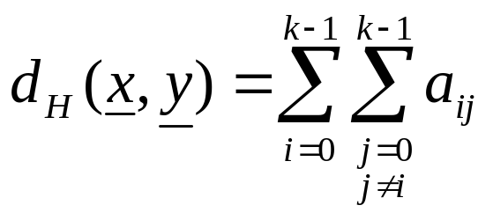
Proximity Measures Between Discrete-Valued Vectors
Several proximity measures can be expressed as combinations of the elements of A(x,y).
  Dissimilarity measures:
    The Hamming distance (number of places where x and y differ)

Slide 5
Proximity Measures Between Discrete-Valued Vectors
Several proximity measures can be expressed as combinations of the elements of A(x,y).
  Dissimilarity measures:
    The Hamming distance (number of places where x and y differ)

Slide 6
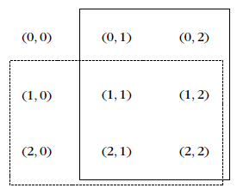
Proximity Measures Between Discrete-Valued Vectors
n_{y}
  Similarity measures:
n_{x}

Slide 7
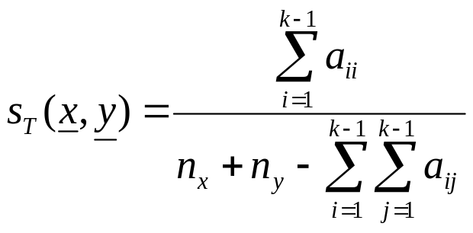
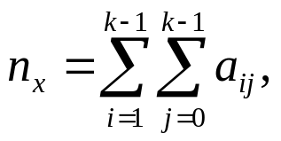
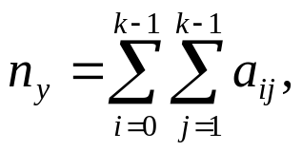
Proximity Measures Between Discrete-Valued Vectors
n_{y}
  Similarity measures:
n_{x}
    Tanimoto measure :
    where

Slide 8
Proximity Measures Between Discrete-Valued Vectors
n_{y}
  Similarity measures:
n_{x}
    Tanimoto measure :
    where

Slide 9
Proximity Measures Between Mixed-Valued Vectors
Some of the coordinates of the vectors x are real and the rest are discrete.
Methods for measuring the proximity between two such x_{i} and x_{j}:
  Adopt a proximity measure (PM) suitable for real-valued vectors.
  Convert the real-valued features to discrete ones and employ a discrete PM.
  The more general case of mixed-valued vectors:
  Here nominal, ordinal, interval-scaled, ratio-scaled features are treated separately.

Slide 10
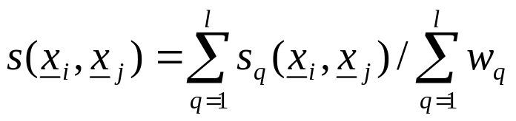
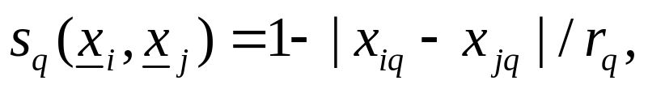
Proximity Measures Between Mixed-Valued Vectors
The similarity function between x_{i} and x_{j} is:
In the above definition:
  w_{q}=0, if one of the q-th coordinates of x_{i} and x_{j} are undefined or both the q-th coordinates are equal to 0. Otherwise w_{q}=1.
  If the q-th coordinates are binary, s_{q}(x_{i},x_{j})=1 if x_{iq}=x_{jq}=1 and 0 otherwise.
  If the q-th coordinates are nominal or ordinal, s_{q}(x_{i},x_{j})=1 if x_{iq}=x_{jq} and 0 otherwise.
  If the q-th coordinates are interval or ratio scaled-valued
  where r_{q} is the interval where the q-th coordinates of the vectors of the data set X lie.

Slide 11
Fuzzy Proximity Measures
Let x, y∈[0,1]^{l}. Here the value of the i-th coordinate, x_{i,} of x, is not the outcome of a measuring device.
  The closer the coordinate x_{i} is to 1 (0), the more likely the vector x possesses (does not possess) the i-th characteristic.
  As x_{i} approaches 0.5, the certainty about the possession or not of the i-th feature from x decreases.

Slide 12
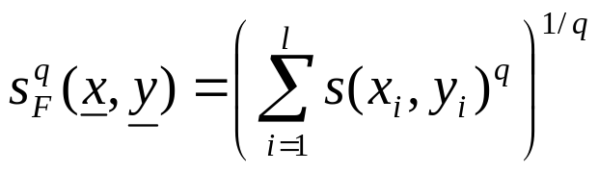
Fuzzy Proximity Measures
A possible similarity measure that can quantify the above is:
Then

Slide 13
Proximity Measures For Missing Data
For some vectors of the data set X, some features values are unknown
Ways to face the problem:
  Discard all vectors with missing values (not recommended for small data sets)
  Find the mean value m_{i} of the available i-th feature values over that data set and substitute the missing i-th feature values with m_{i}.

Slide 14
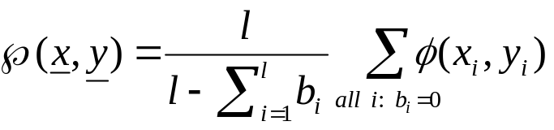
Proximity Measures For Missing Data
  Define b_{i}=0, if both the i-th features x_{i}, y_{i} are available and b_{i}=1 otherwise. Then
  where φ(x_{i},y_{i}) denotes the PM between two scalars x_{i}, y_{i}.

Slide 15
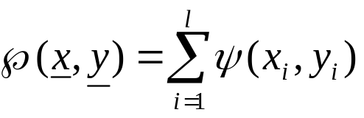
Proximity Measures For Missing Data
  Find the average proximities φ_{avg}(i) between all feature vectors in X along all components. Then
  where ψ(x_{i},y_{i})=φ(x_{i},y_{i}), if both x_{i} and y_{i} are available and φ_{avg}(i) otherwise.

Slide 16
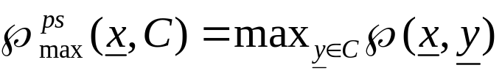

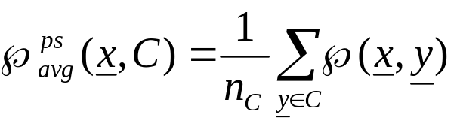
Proximity Functions Between A Vector and A Set
Let X={x₁,x₂,…,x_{N}} and C ⊂ X, x ∈ X
All points of C contribute to the definition of ℘(x, C)
  Max proximity function
  Min proximity function
  Average proximity function
(n_{C} is the cardinality of C)

Slide 17
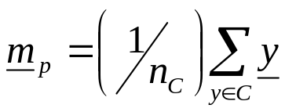
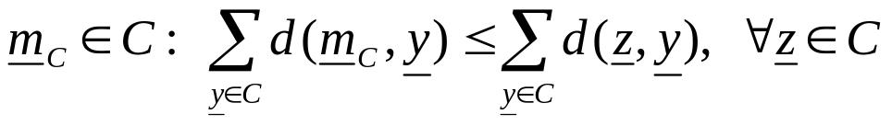
A representative(s) of C, r_{C} , contributes to the definition of ℘(x,C)
In this case: ℘(x,C)=℘(x,r_{C})
Typical representatives are:
  The mean vector:
  The mean center:
  The median center:
NOTE: Other representatives (e.g., hyperplanes, hyperspheres) are useful in certain applications (e.g., object identification using clustering techniques).
where n_{C} is the cardinality of C
d: a dissimilarity measure

Slide 18
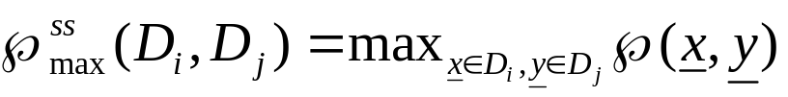

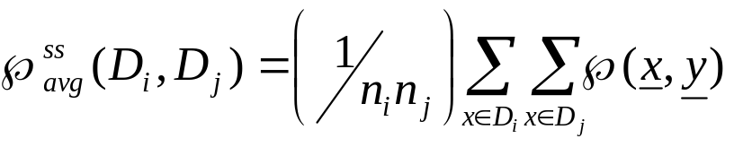
Proximity Functions Between Sets
Let X={x₁,…,x_{N}}, D_{i}, D_{j} ⊂ X and n_{i}=|D_{i}|, n_{j}=|D_{j}|
All points of each set contribute to ℘(D_{i},D_{j})
  Max proximity function
  Min proximity function
  Average proximity function

Slide 19

Proximity Functions Between Sets
Each set D_{i} is represented by its representative vector m_{i}
  Mean proximity function (it is a measure provided that ℘ is a measure):

Slide 20
Remarks:
  Different choices of proximity functions between sets may lead to totally different clustering results.
  Different proximity measures between vectors in the same proximity function between sets may lead to totally different clustering results.
  The only way to achieve a proper clustering is
    by trial and error and,
    taking into account the opinion of an expert in the field of application.

Slide 21
CLUSTERING ALGORITHMS
Number of possible clusterings
Let X={x₁,x₂,…,x_{N}}.
Question: In how many ways the N points can be
assigned into m groups?
Answer: ?

Slide 22

CLUSTERING ALGORITHMS
Number of possible clusterings
Let X={x₁,x₂,…,x_{N}}.
Question: In how many ways the N points can be
assigned into m groups?
Answer: ?
Let S(N, m) = number of possible ways of clusterings
is the list of all possible clusterings of N vectors into m groups

Slide 23
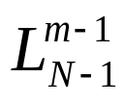
CLUSTERING ALGORITHMS
Number of possible clusterings
Let X={x₁,x₂,…,x_{N}}.
Question: In how many ways the N points can be
assigned into m groups?
Answer: ?
Let S(N, m) = number of possible ways of clusterings
is the list of all possible clusterings of N vectors into m groups
Therefore,
is the list containing all possible clusterings of the N - 1 vectors into m -1 groups

Slide 24
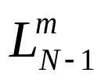
CLUSTERING ALGORITHMS
Number of possible clusterings
Let X={x₁,x₂,…,x_{N}}.
Question: In how many ways the N points can be
assigned into m groups?
Answer: ?
is the list of all possible clusterings of N vectors into m groups
Therefore,
be the list containing all possible clusterings of the N -1 vectors into m-1 groups
be the list containing all possible clusterings of the N -1 vectors into m groups

Slide 25
CLUSTERING ALGORITHMS
Number of possible clusterings
Let X={x₁,x₂,…,x_{N}}.
Question: In how many ways the N points can be
assigned into m groups?
Answer: ?
Now find from and , in two ways:
Either will be added to one of the clusters of any member of
Or will form a new cluster to each member of

Slide 26
CLUSTERING ALGORITHMS
Number of possible clusterings
Let X={x₁,x₂,…,x_{N}}.
Question: In how many ways the N points can be
assigned into m groups?
Answer: ?
Now find from and , in two ways:
Either will be added to one of the clusters of any member of
Or will form a new cluster to each member of
Therefore, S(N, m) = mS(N -1, m) + S(N - 1, m - 1)

Slide 27
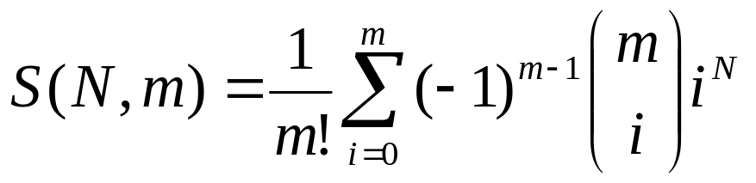
CLUSTERING ALGORITHMS
Number of possible clusterings
Let X={x₁,x₂,…,x_{N}}.
Question: In how many ways the N points can be
assigned into m groups?
Answer:

Slide 28

CLUSTERING ALGORITHMS
Number of possible clusterings
Let X={x₁,x₂,…,x_{N}}.
Question: In how many ways the N points can be
assigned into m groups?
Answer:
  Examples:

Slide 29


CLUSTERING ALGORITHMS
Number of possible clusterings
Let X={x₁,x₂,…,x_{N}}.
Question: In how many ways the N points can be
assigned into m groups?
Answer:
  Examples:

Slide 30

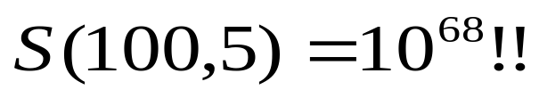
CLUSTERING ALGORITHMS
Number of possible clusterings
Let X={x₁,x₂,…,x_{N}}.
Question: In how many ways the N points can be
assigned into m groups?
Answer:
  Examples:

Slide 31
A way out:
  Consider only a small fraction of clusterings of X and select a “sensible” clustering among them.
    Question 1: Which fraction of clusterings is considered?
    Question 2: What “sensible” means?
    The answer depends on the specific clustering algorithm and the specific criteria to be adopted.

Slide 32
Clustering Algorithms
2 Important distinctions: hierarchical and partitional
Partitional Clustering
  A division data objects into non-overlapping subsets (clusters) such that each data object is in exactly one subset
Hierarchical clustering
  A set of nested clusters organized as a hierarchical tree

Slide 33

Partitional Clustering
Original Points
A Partitional Clustering

Slide 34
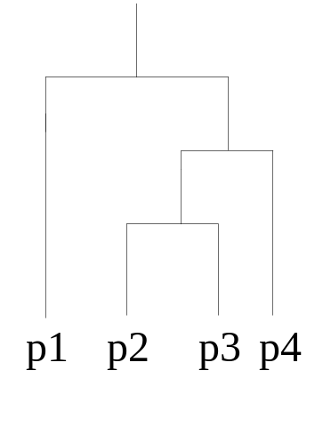
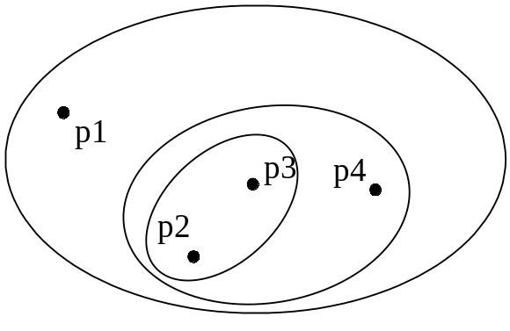
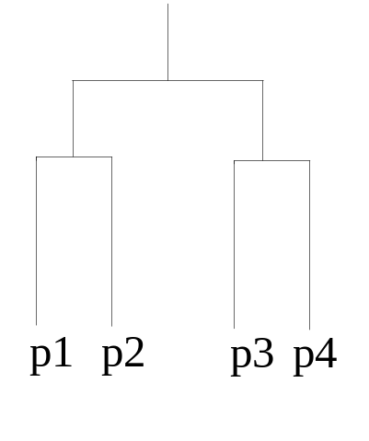
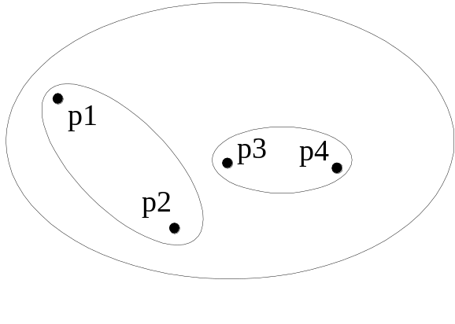
Hierarchical Clustering
Traditional Hierarchical Clustering
Traditional Dendrogram
Non-traditional Hierarchical Clustering
Non-traditional Dendrogram

Slide 35
Hierarchical Clustering
Hierarchical: A sequence of (nested) clusterings is produced.
  Agglomerative
  Divisive
  Combinations of the above (e.g., the Chameleon algorithm.)

Slide 36
OTHER MAJOR CATEGORIES OF CLUSTERING ALGORITHMS
Sequential: A single clustering is produced. One or few sequential passes on the data.

Slide 37
Cost function optimization. For most of the cases a
single clustering is obtained.
  Hard clustering (each point belongs exclusively to a single cluster):
    Basic hard clustering algorithms (e.g., k-means)
    Branch and bound
    Boundary detection
    Genetic clustering algorithms
    …
    ..
    .
  Fuzzy clustering (each point belongs to more than one clusters simultaneously).
  Probabilistic clustering (it is based on the probability of a point to belong to a cluster).

Slide 38
Other schemes:
  Exclusive versus non-exclusive
    In non-exclusive clusterings, points may belong to multiple clusters.
    Can represent multiple classes or ‘border’ points
  Partial versus complete
    In some cases, we only want to cluster some of the data
  Heterogeneous versus homogeneous
    Cluster of widely different sizes, shapes, and densities

Slide 39
Other schemes:
  Algorithms based on graph theory (e.g., Minimum Spanning Tree, regions of influence, directed trees).
  Density based clustering algorithms.
  Subspace clustering algorithms.
  Kernel based methods

Slide 40
Clustering and Clusters :Difference?
Types of Clusters
Well-separated clusters
Center-based clusters
Contiguous clusters
Density-based clusters
Property or Conceptual
Described by an Objective Function

Slide 41
Types of Clusters: Well-Separated
Well-Separated Clusters:
  A cluster is a set of points such that any point in a cluster is closer (or more similar) to every other point in the cluster than to any point not in the cluster.
B
A
C
3 well-separated clusters

Slide 42
Types of Clusters: Center-Based
Center-based
  A cluster is a set of objects such that an object in a cluster is closer (more similar) to the “center” of a cluster, than to the center of any other cluster
  The center of a cluster is often a centroid, the average of all the points in the cluster, or a medoid, the most “representative” point of a cluster
A
C₂
C₁
4 center-based clusters

Slide 43
Types of Clusters: Contiguity-Based
Contiguous Cluster (Nearest neighbor or Transitive)
  A cluster is a set of points such that a point in a cluster is closer (or more similar) to one or more other points in the cluster than to any point not in the cluster.
8 contiguous clusters

Slide 44
Types of Clusters: Density-Based
Density-based
  A cluster is a dense region of points, which is separated by low-density regions, from other regions of high density.
  Used when the clusters are irregular or intertwined, and when noise and outliers are present.
Area of low density
Area of high density
6 density-based clusters

Slide 45
Types of Clusters: Conceptual Clusters
Shared Property or Conceptual Clusters
  Finds clusters that share some common property or represent a particular concept.
2 Overlapping Circles

Slide 46
SEQUENTIAL CLUSTERING ALGORITHMS
Characteristics:
  One or very few passes on the data
  No a-prior knowledge about the number of clusters
  The clusters are defined with the aid of
    An appropriately defined distance d (x,C) of a point from a cluster.
    A threshold Θ associated with the distance.

Slide 47
Basic Sequential Clustering Algorithm (BSAS)
  m=1 \ {number of clusters}\
  C_{m}={x₁}
  For i=2 to N
    Find C_{k}: d(x_{i},C_{k})=min_{1≤j≤m}d(x_{i},C_{j})
    If (d(x_{i},C_{k})>Θ) AND (m<q) then
      m=m+1
      C_{m}={x_{i}}
    Else
      C_{k}=C_{k}∪{x_{i}}
      Where necessary, update representatives (*)
    End {if}
  End {for}

Slide 48
Basic Sequential Clustering Algorithm (BSAS)
  m=1 \{number of clusters}\
  C_{m}={x₁}
  For i=2 to N
    Find C_{k}: d(x_{i},C_{k})=min_{1≤j≤m}d(x_{i},C_{j})
    If (d(x_{i},C_{k})>Θ) AND (m<q) then
      m=m+1
      C_{m}={x_{i}}
    Else
      C_{k}=C_{k}∪{x_{i}}
      Where necessary, update representatives (*)
    End {if}
  End {for}
(*) When the mean vector m_{C} is used as representative of the cluster C with n_{c} elements, the updating in the light of a new vector x becomes
m_{C}^{new}=(n_{C} m_{C} + x) / (n_{C}+1)

Slide 49
Remarks:
  The order of presentation of the data in the algorithm plays important role in the clustering results.
    Different order of presentation may lead to totally different clustering results

Slide 50
Remarks:
  The order of presentation of the data in the algorithm plays important role in the clustering results.
    Different order of presentation may lead to totally different clustering results
  In BSAS the decision for a vector x is reached prior to the final cluster formation.

Slide 51
Remarks:
  The order of presentation of the data in the algorithm plays important role in the clustering results.
    Different order of presentation may lead to totally different clustering results
  In BSAS the decision for a vector x is reached prior to the final cluster formation.
  BSAS perform a single pass on the data. Its complexity is O(N).

Slide 52
Estimating the number of clusters in the data set:
25
15
5
-5
-5
5
15
25

Slide 53
Estimating the number of clusters in the data set:
Let BSAS(Θ) denote the BSAS algorithm when the dissimilarity threshold is Θ.
  Find
    a, the maximum and
    b, the minimum distances among the points
25
15
5
-5
-5
5
15
25

Slide 54
Estimating the number of clusters in the data set:
Let BSAS(Θ) denote the BSAS algorithm when the dissimilarity threshold is Θ.
  For Θ=a to b step c
    Run s times BSAS(Θ), each time presenting the data in a different order.
    Estimate the number of clusters m_{Θ}, as the most frequent number resulting from the s runs of BSAS(Θ).
  Next Θ
25
15
5
-5
-5
5
15
25

Slide 55
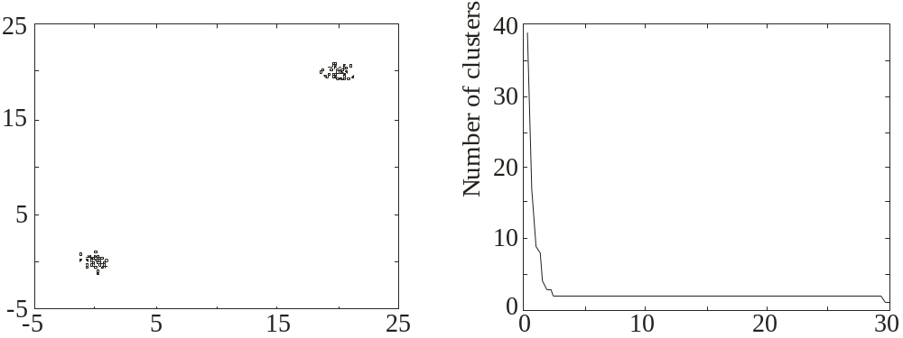
Estimating the number of clusters in the data set:
Let BSAS(Θ) denote the BSAS algorithm when the dissimilarity threshold is Θ.
  For Θ=a to b step c
    Run s times BSAS(Θ), each time presenting the data in a different order.
    Estimate the number of clusters m_{Θ}, as the most frequent number resulting from the s runs of BSAS(Θ).
  Next Θ
  Plot m_{Θ} versus Θ and identify the number of clusters m as the one corresponding to the widest flat region in the above graph.
Θ

Slide 56
MBSAS, a modification of BSAS
In BSAS a decision for a data vector x is reached prior to the final cluster formation, which is determined after all vectors have been presented to the algorithm.

Slide 57
MBSAS, a modification of BSAS
In BSAS a decision for a data vector x is reached prior to the final cluster formation, which is determined after all vectors have been presented to the algorithm.
  MBSAS deals with the above drawback, at the cost of presenting the data twice to the algorithm.

Slide 58
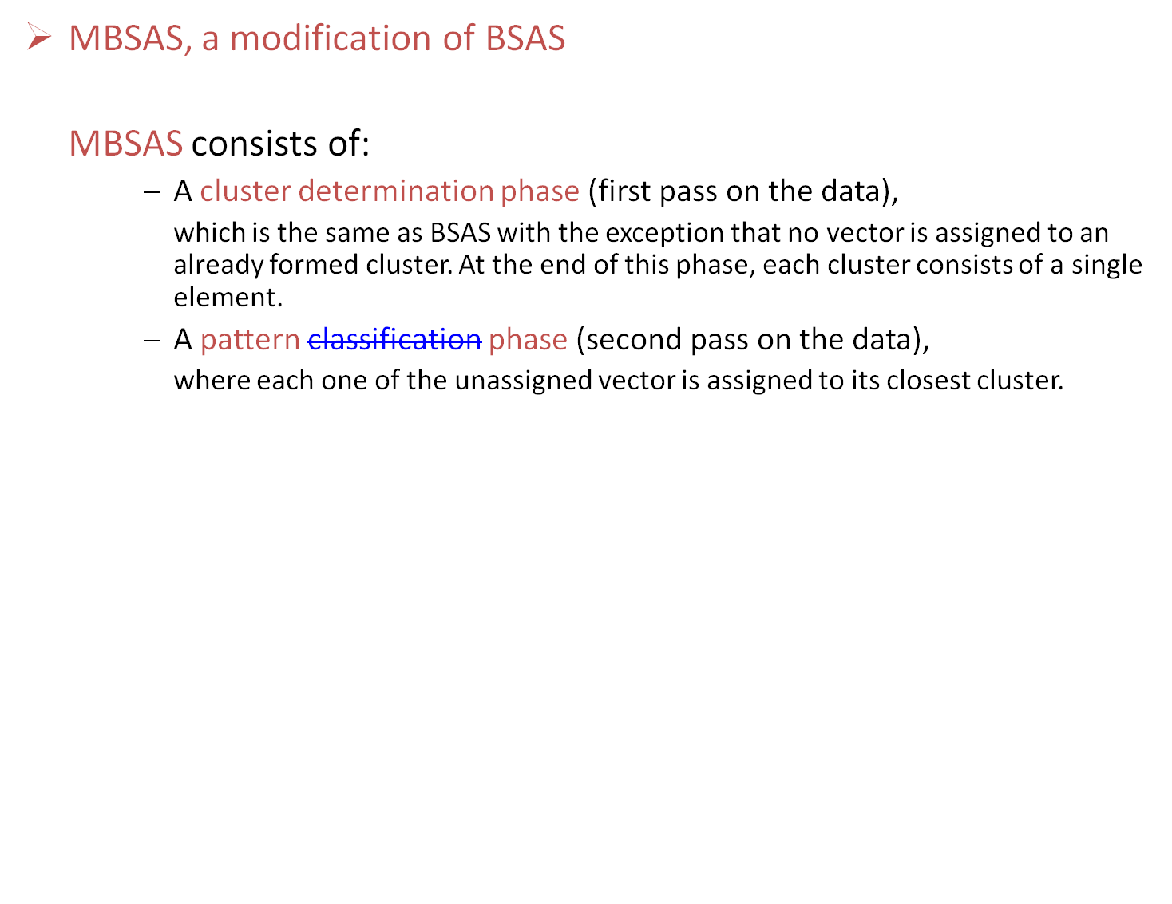

Slide 59
MBSAS, a modification of BSAS
Cluster Determination
  m=1 \ {number of clusters}\
  C_{m}={x₁}
  For i=2 to N
    Find C_{k}: d(x_{i},C_{k})=min_{1≤j≤m}d(x_{i},C_{j})
    If (d(x_{i},C_{k})>Θ) AND (m<q) then
      m=m+1
      C_{m}={x_{i}}
    End {if}
  End {for}

Slide 60
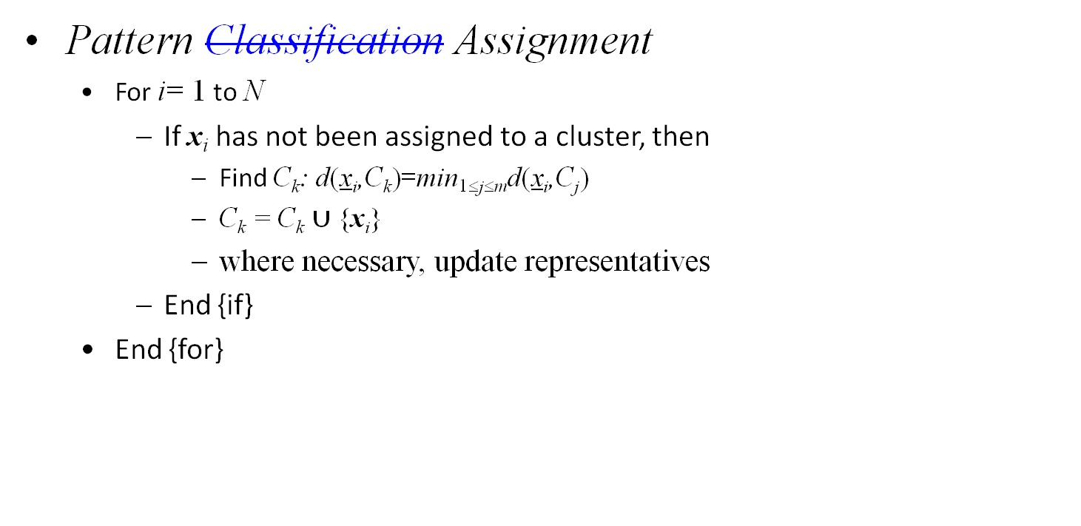
MBSAS, a modification of BSAS

Slide 61
MBSAS, a modification of BSAS
Remarks:
  decision for a vector x during the pattern classification phase is reached taking into account all clusters.
  still sensitive to the order of presentation of the vectors.
  requires two passes on the data. complexity is O(N).

Slide 62
The maxmin algorithm, a variant of MBSAS
Let X= the set of all data points
W = the set of all points that have been chosen to form clusters up to the current iteration step.

Slide 63
The maxmin algorithm, a variant of MBSAS
cluster formation:
    For each x∈X-W determine d_{x}=min_{z∈W} d(x,z)
    Determine y: d_{y}=max_{x∈X-W}d_{x}
    If d_{y} is greater than a pre-specified threshold then
      this vector forms a new cluster
    else
      the cluster determination phase of the algorithm terminates.
    End {if}
pattern classification:
assign each unassigned vector to its closest cluster

Slide 64
Remarks:
  The maxmin algorithm is more computationally demanding than MBSAS.
  However, it is expected to produce better clustering results.

Slide 65
A two-threshold sequential scheme (TTSAS)
  The formation of the clusters, as well as the assignment of vectors to clusters, is carried out concurrently (like BSAS and unlike MBSAS)
  Two thresholds Θ₁ and Θ₂ (Θ₁<Θ₂) are employed

Slide 66
A two-threshold sequential scheme (TTSAS)
  The general idea is the following:
    If the distance d(x,C) of x from its closest cluster, C, is greater than Θ₂ then:
      A new cluster represented by x is formed.
    Else if d(x,C)<Θ₁ then
      x is assigned to C.
    Else
      The decision is postponed to a later stage.
    End {if}

Slide 67
A two-threshold sequential scheme (TTSAS)
  The general idea is the following:
    If the distance d(x,C) of x from its closest cluster, C, is greater than Θ₂ then:
      A new cluster represented by x is formed.
    Else if d(x,C)<Θ₁ then
      x is assigned to C.
    Else
      The decision is postponed to a later stage.
    End {if}
The unassigned vectors are presented iteratively to the algorithm
until all of them are classified.

Slide 68
Remarks:
  In practice, a few passes (≥2) of the data set are required.
  TTSAS is less sensitive to the order of data presentation, compared to BSAS.

Slide 69
Refinement stages
Why necessary?
The problem of closeness of clusters: “In all the above algorithms it may happen that two formed clusters lie very close to each other”.

Slide 70
Refinement stages
  A simple merging procedure
    (A) Find C_{i}, C_{j} (i<j) such that d(C_{i},C_{j})=min_{k,r=1,…,m,k≠r}d(C_{k},C_{r})
    If d(C_{i},C_{j})≤M₁ then \{ M₁ is a user-defined threshold \}
      Merge C_{i}, C_{j} to C_{i} and eliminate C_{j} .
      If necessary, update the cluster representative of C_{i} .
      Rename the clusters C_{j+1},…,C_{m} to C_{j},…,C_{m-1}, respectively.
      m=m-1
      Go to (A)
    Else
      Stop
    End {if}

Slide 71
Reassignment of vectors
Why necessary?
The problem of sensitivity to the order of data presentation:
“A vector x may have been assigned to a cluster C_{i} at the current stage but another cluster C_{j} may be formed at a later stage that lies closer to x”

Slide 72
  A simple reassignment procedure
    For i=1 to N
      Find C_{j} such that d(x_{i},C_{j})=min_{k=1,…,m}d(x_{i},C_{k})
      Set b(i)=j \{ b(i) is the index of the cluster that lies closet to x_{i} \}
    End {for}
    For j=1 to m
      Set C_{j}={x_{i}∈X: b(i)=j}
      If necessary, update representatives
    End {for}

